Slide 1
Dr. Yifeng Zhu Electrical and Computer Engineering University of Maine
Embedded Systems with ARM Cortex-M Microcontrollers in Assembly Language and C
Chapter 7
Structured Programming
Fall 2025

Slide 2
Divide and Conquer
"Nothing is particularly hard if you divide it into small jobs."
Henry Ford
Founder of Ford Motor

Slide 3
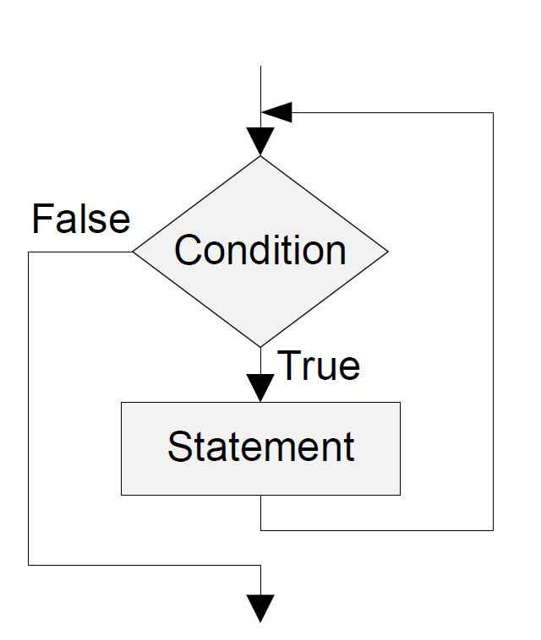
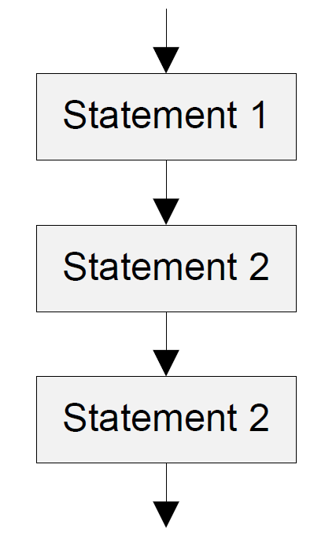
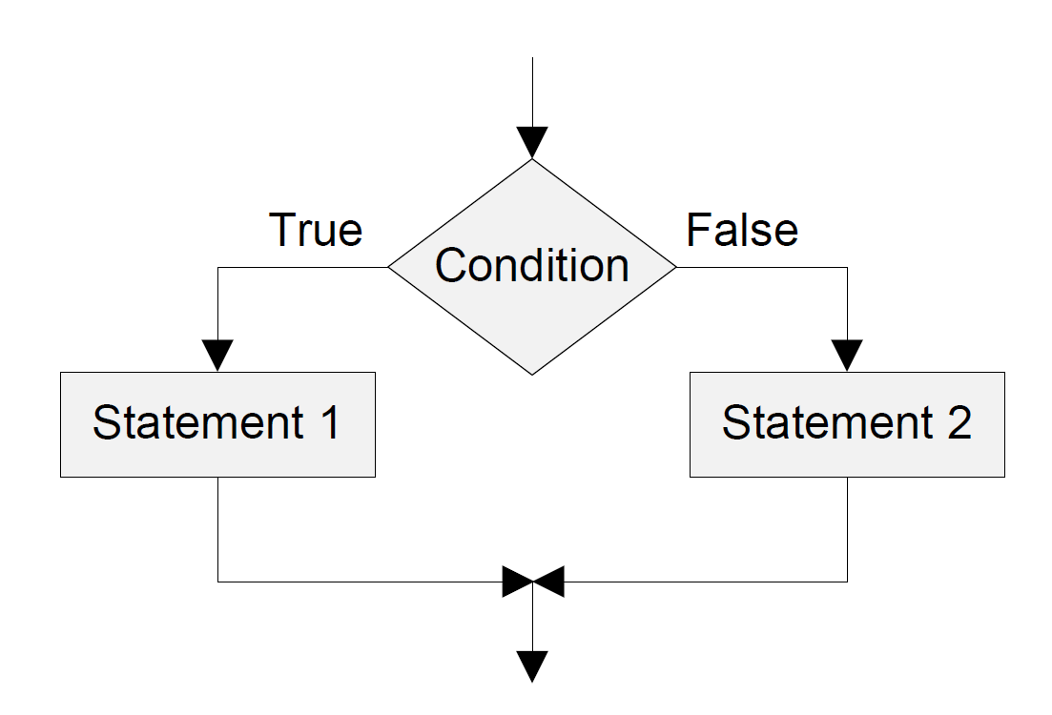
Basic Control Structures
Sequence Structure
Selection Structure
Loop Structure

Slide 4
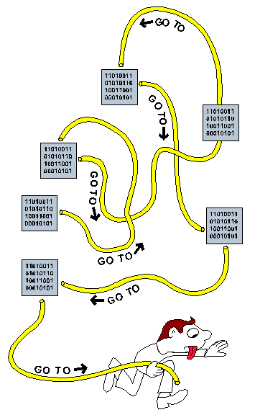
History
Spaghetti Code
Before the 1980s, program flow bounces around anywhere the programmer wanted.
Culprit: overusing “GOTO” statements
Spaghetti code in BASIC
1 i=0
2 i=i+1
3 PRINT i; "squared=";i*i
4 IF i>=100 THEN GOTO 6
5 GOTO 2
6 PRINT "Program Completed."
7 END
Structured programming in BASIC
1 FOR i=1 TO 100
2 PRINT i;"squared=";i*i
3 NEXT i 'termination of loop body
4 PRINT "Program Completed."
5 END
https://en.wikipedia.org/wiki/Spaghetti_code
https://commons.wikimedia.org/wiki/File:Spagetti_code_structural_graphic.GIF

Slide 5
Importance of Structured Programming
Assembly is not a structured programming language
Does not directly support selection and loop
Branch in assembly = “goto” in C
Break the single-entry single-exit rule
Easy to generate spaghetti code in assembly
Twisted and tangled
Difficult to debug & maintain
One strategy to alleviate the challenge
Use flowcharts to facilitate assembly programming
That is why textbook has many flowcharts
How to build flowcharts?

Slide 6
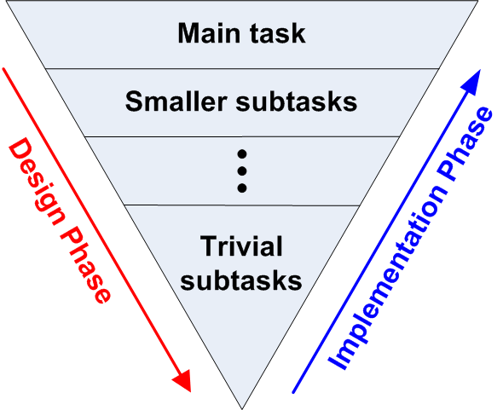
Software Design Strategy: Top-Down Design
Three common design strategies
Top-down, also known as stepwise refinement
Bottom up
Object oriented
Top-down: Repeatedly break down tasks into smaller and smaller pieces until they are easy to solve
Example: Planning a picnic
Task 1: Where
Task 2: When
Task 3: Who
Task 4: Food

Slide 7



Top-Down Design Example
Find all Armstrong numbers less than 10,000
Given a positive integer that has n digits, it is an Armstrong number if the sum of the n^{th} powers of its digits equals the number itself.
$$153=1^{3}+5^{3}+3^{3}$$
$$371=3^{3}+7^{3}+1^{3}$$
$$1634=1^{4}+6^{4}+3^{4}+4^{4}$$

Slide 8
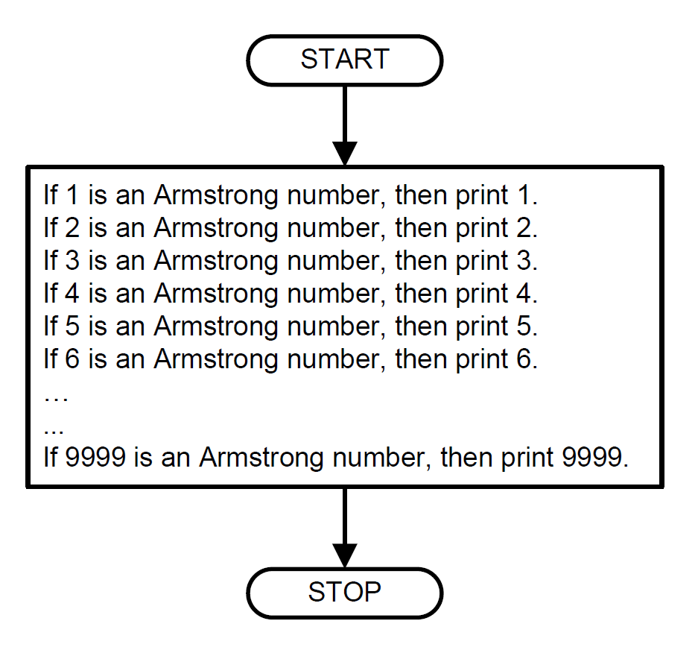
Top-Down Design Example

Slide 9
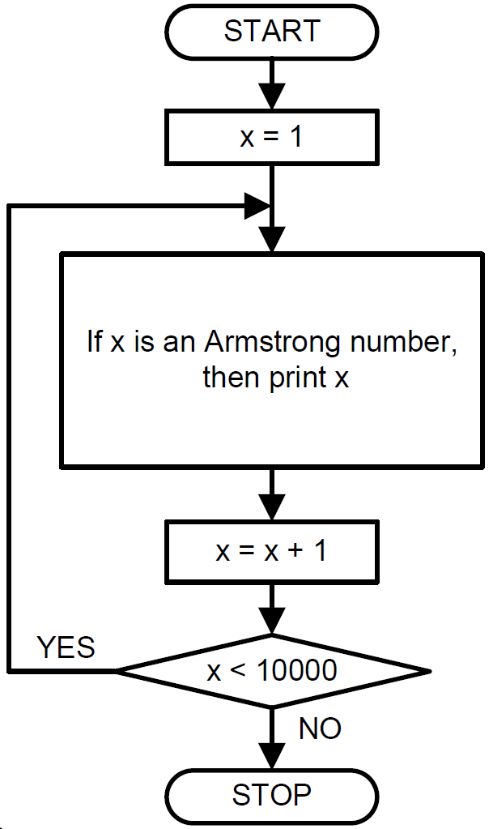
Top-Down Design Example

Slide 10
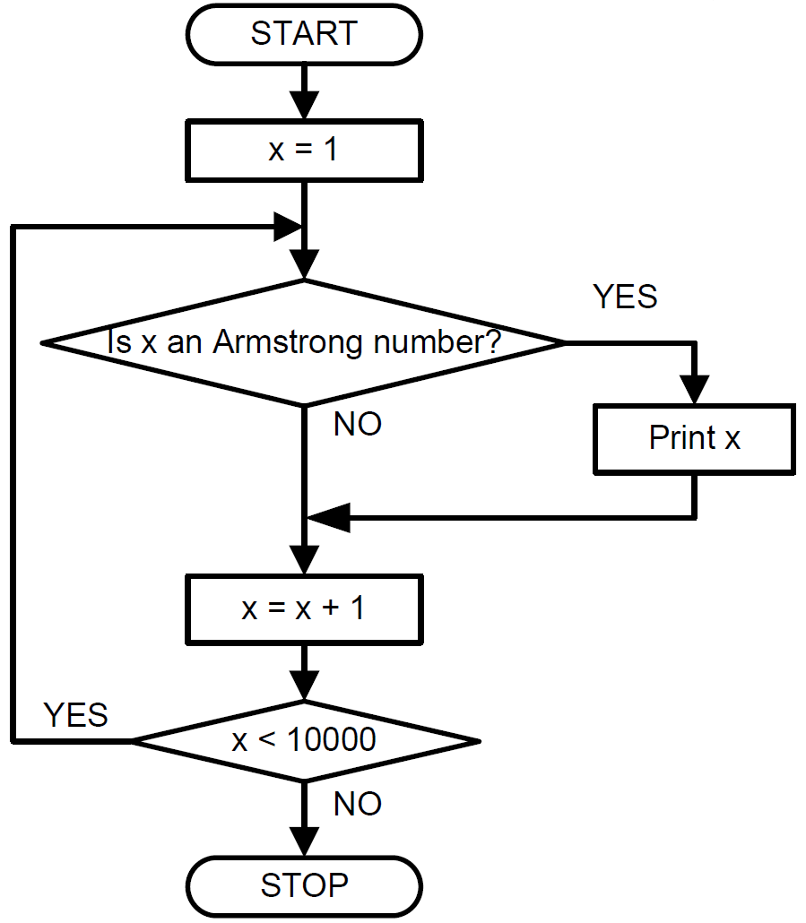
Top-Down Design Example

Slide 11
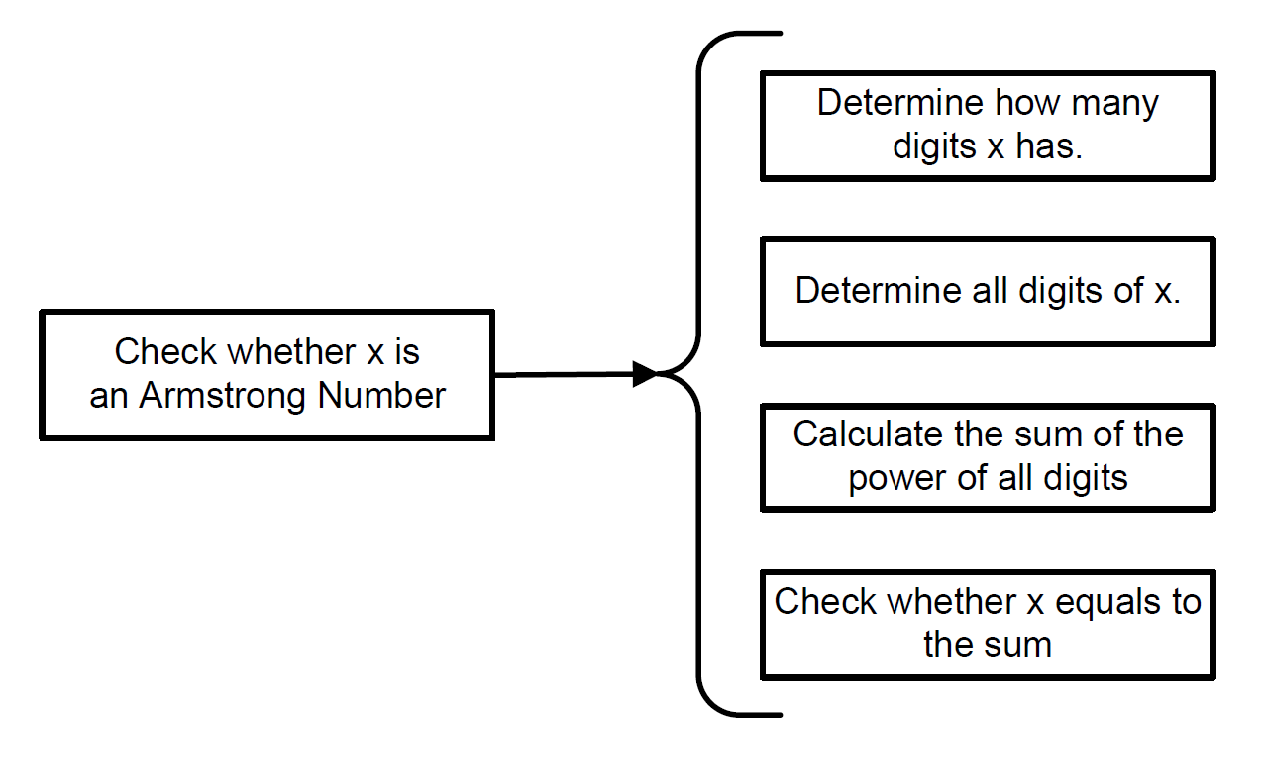
Top-Down Design Example

Slide 12
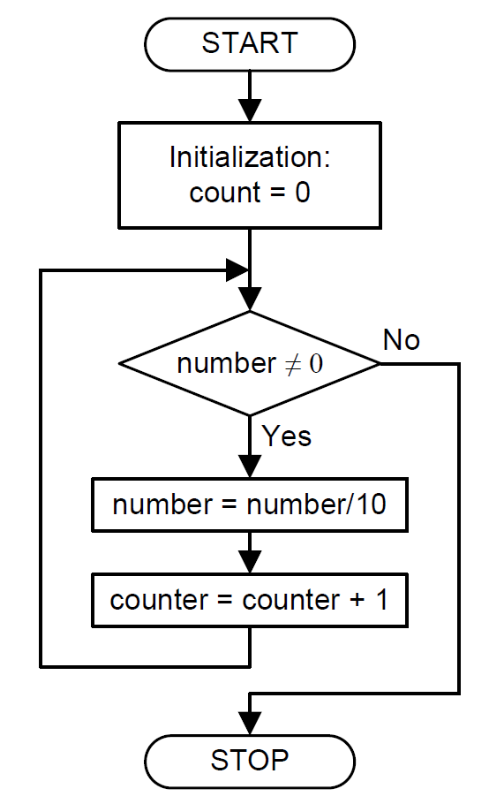
Top-Down Design Example: Counting digits

Slide 13
Reuse Registers
int A = 0; // 0x00000000
int B = -1; // 0xFFFFFFFF
int C = -2; // 0xFFFFFFFE
int D = 2; // 0x00000002
void main(void){
A = B + C – D;
return;
}

Slide 14
Reuse Registers
AREA myCode, CODE
EXPORT __main
ENTRY
__main PROC
LDR r2, =B ; r2 = 0x2000,0004
LDR r3, [r2] ; r3 = B = -1
LDR r4, =C ; r4 = 0x2000,0008
LDR r5, [r4] ; r5 = C = -2
LDR r6, =D ; r6 = 0x2000,000B
LDR r7, [r6] ; r7 = D = 2
ADD r1, r3, r5 ; r1 = B + C
SUB r1, r1, r7 ; r1 = B + C - D
LDR r0, =A ; r0 = 0x2000,0000
STR r1, [r0] ; Save A
ENDP
AREA myData, DATA
A DCD 0
B DCD -1
C DCD -2
D DCD 2
END
int A = 0; // 0x00000000
int B = -1; // 0xFFFFFFFF
int C = -2; // 0xFFFFFFFE
int D = 2; // 0x00000002
void main(void){
A = B + C – D;
return;
}
Eight registers are used:
R0,r1,r2,r3,r4,r5,r6,r7

Slide 15
Reuse Registers

Slide 16
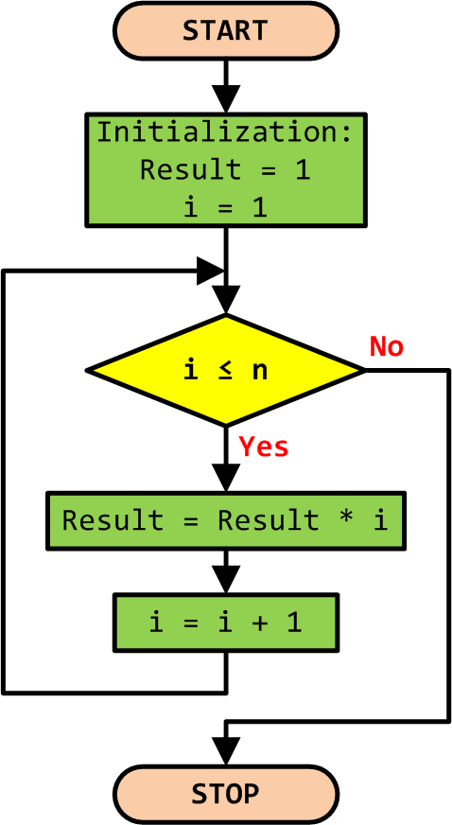
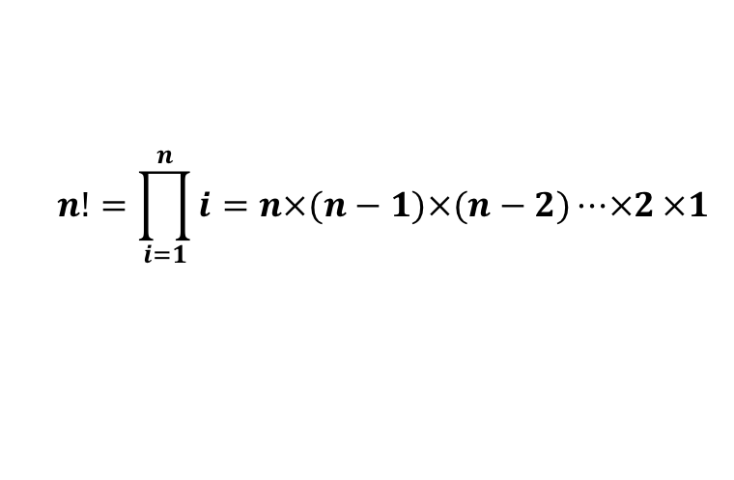
Example 1: Factorial Numbers
$$n!=\prod_{i=1}^{n}{i=n×(n−1)×(n−2)⋯×2}×1$$

Slide 17
Example 1: Factorial Numbers
C Program | Assembly Program
int main(void) { int result, n, i; | AREA factorial, CODE, READONLY EXPORT __main ENTRY __main PROC
result = 1; n = 5; | MOV r0, #1 ; r0 = result MOV r1, #5 ; r1 = n
for (i = 1; i <= n; i++) result = result * i; | MOV r2, #1 ; r2 = i = 1 loop CMP r2, r1 ; compare i and n BGT stop ; if i > n, stop MULS r0, r2, r0 ; result *= i ADD r2, r2, #1 ; i++ B loop
while(1); } | stop B stop ENDP END

Slide 18
Example 2: Counting Ones in a Word
Assembly Program
AREA Count_Ones, CODE
EXPORT __main
ALIGN
ENTRY
__main PROC
; r0 = Input = x
; r1 = Number of ones = counter
LDR r0, =0xAAAAAAAA
; r1 = r0 >> 31
MOV r1, r0, LSR #31
; r0 = r0 << 2 and change Carry
loop MOVS r0, r0, LSL #2
; r1 = r1 + r0 >> 31 + Carry
ADC r1, r1, r0, LSR #31
BNE loop
stop B stop
ENDP
END
At the end of the first loop: r1 = b31 + b30 + b29

Slide 19
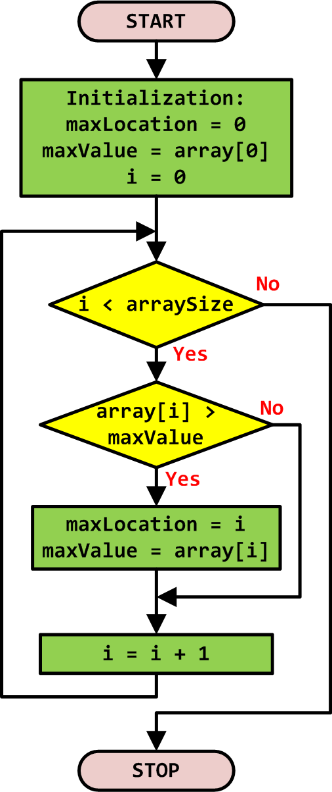
Example 3: Finding Max of an Array
// Initialize max and location maxLocation = 0; maxValue = array[0];
// Loop through the array for (i = 0; i < arraySize; i++) { if (array[i] > maxValue) { maxValue = array[i]; maxLocation = i; } }

Slide 20
Example 3: Finding Max of an Array
C Program | Assembly Program
int array[10] = {-1, 5, 3, 8, 10, 23, 6, 5, 2, -10}; int size = 10; | AREA myData, DATA ALIGN array DCD -1,5,3,8,10,23,6,5,2,-10 size DCD 10
int main(void) { int i, maxLocation, maxValue; | AREA findMax, CODE EXPORT __main ALIGN ENTRY __main PROC ; Identify the array size LDR r3, =size LDR r3, [r3] ; array size SUB r3, r3, #1
// Initialize max and location maxLocation = 0; maxValue = array[0]; | ; Initialize max value and location LDR r4, =array LDR r0, [r4] ; r0 = default max MOV r1, #0 ; r1 = max location
// Loop through the array for (i = 0; i < size; i++){ if (array[i] > maxValue) { maxValue = array[i]; maxLocation = i; } } | ; Loop over the array MOV r2, #0 ; loop index i loop CMP r2, r3 ; compare i & size BGE stop ; stop if i ≥ size LDR r5, [r4,r2,LSL #2] ; array[i] CMP r5, r0 ; compare with max MOVGT r0, r5 ; update max value MOVGT r1, r2 ; update location ADD r2, r2, #1 ; update index i B loop
while(1); //dead loop } | stop B stop ; dead loop ENDP END

